Slide 1
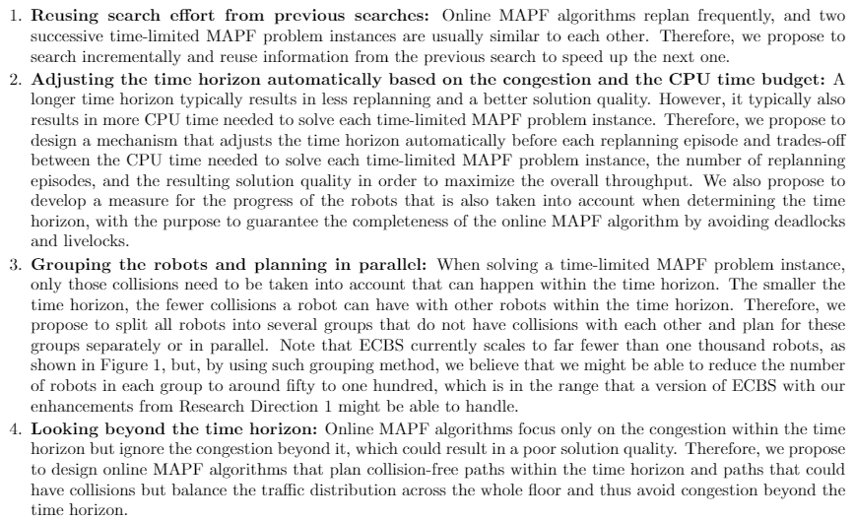
Motivation
Two questions:
How do we group the agents?
How do we resolve collisions between different groups?

Slide 2
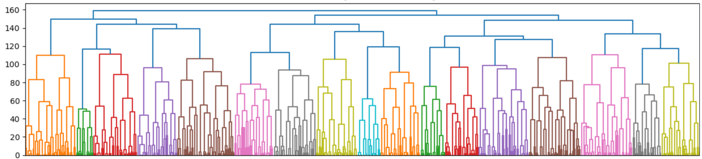
Motivation
Hierarchical clustering
Dendrogram:
Define a distance between two agents that captures the likelihood of their paths being collision-free.
Merge the groups in a “bottom-up” manner.

Slide 3
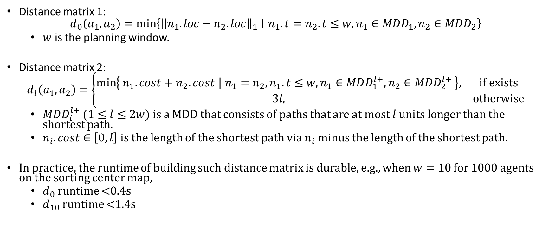
Distance matrix
Distance matrix 1:
$$d_{0}\left(a_{1},a_{2}\right)=\min\left\{{\left\|n_{1}.loc−n_{2}.loc\right\|}_{1}∣n_{1}.t=n_{2}.t≤w,n_{1}∈MDD_{1},n_{2}∈MDD_{2}\right\}$$
$w$ is the planning window.
Distance matrix 2:
$$d_{l}\left(a_{1},a_{2}\right)=\left\{\begin{matrix}\min\left\{n_{1}.cost+n_{2}.cost ∣ n_{1}=n_{2},n_{1}.t≤w,n_{1}∈MDD_{1}^{l+},n_{2}∈MDD_{2}^{l+}\right\}, & if exists \\ 3l, & otherwise\end{matrix}\right.$$
$MDD_{i}^{l+}$ ($1≤l≤2w$) is a MDD that consists of paths that are at most $l$ units longer than the shortest path.
$n_{i}.cost∈\left[0, l\right]$ is the length of the shortest path via $n_{i}$ minus the length of the shortest path.
In practice, the runtime of building such distance matrix is durable, e.g., when $w=10$ for 1000 agents on the sorting center map,
$d_{0}$runtime <0.4s
$d_{10}$runtime <1.4s

Slide 4
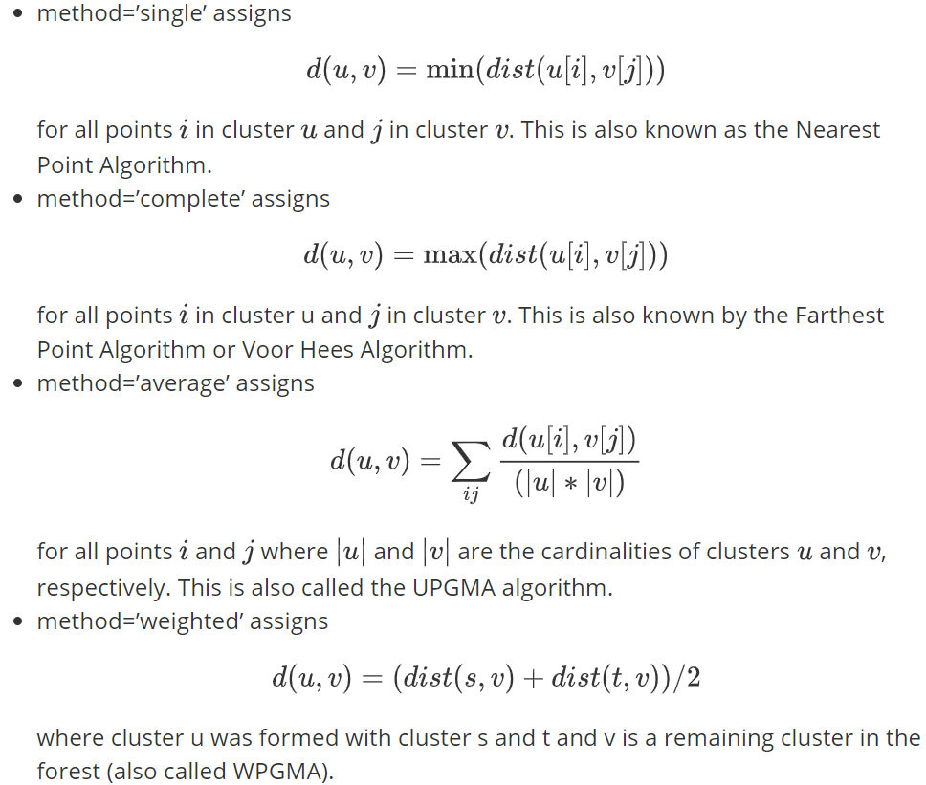
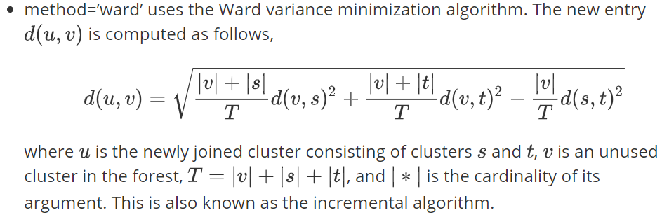
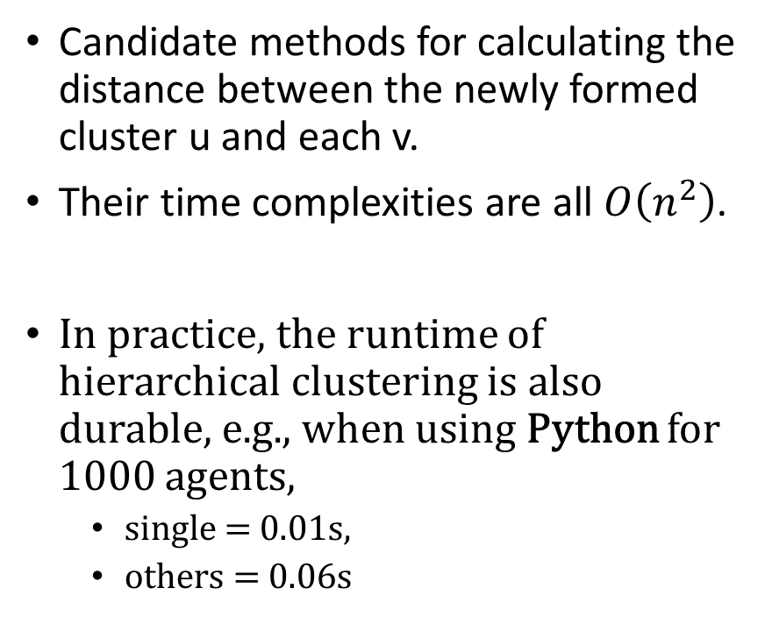
Hierarchical Clustering
Candidate methods for calculating the distance between the newly formed cluster u and each v.
Their time complexities are all $O\left(n^{2}\right)$.
In practice, the runtime of hierarchical clustering is also durable, e.g., when using Python for 1000 agents,
single = 0.01s,
others = 0.06s
https://docs.scipy.org/doc/scipy/reference/generated/scipy.cluster.hierarchy.linkage.html#scipy.cluster.hierarchy.linkage

Slide 5
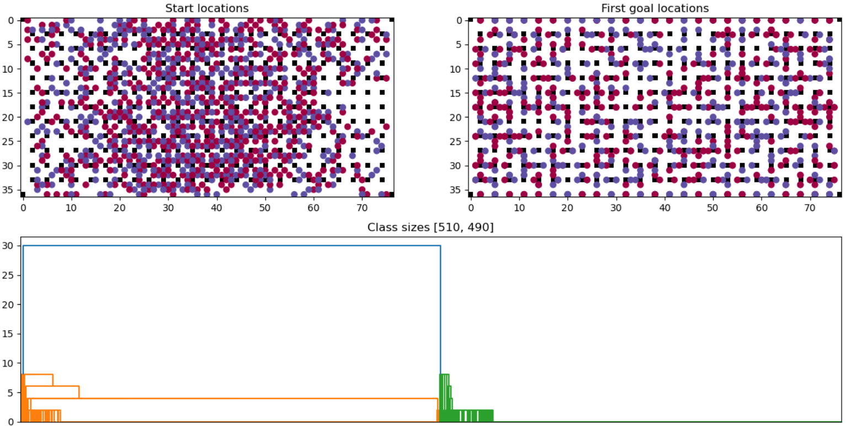
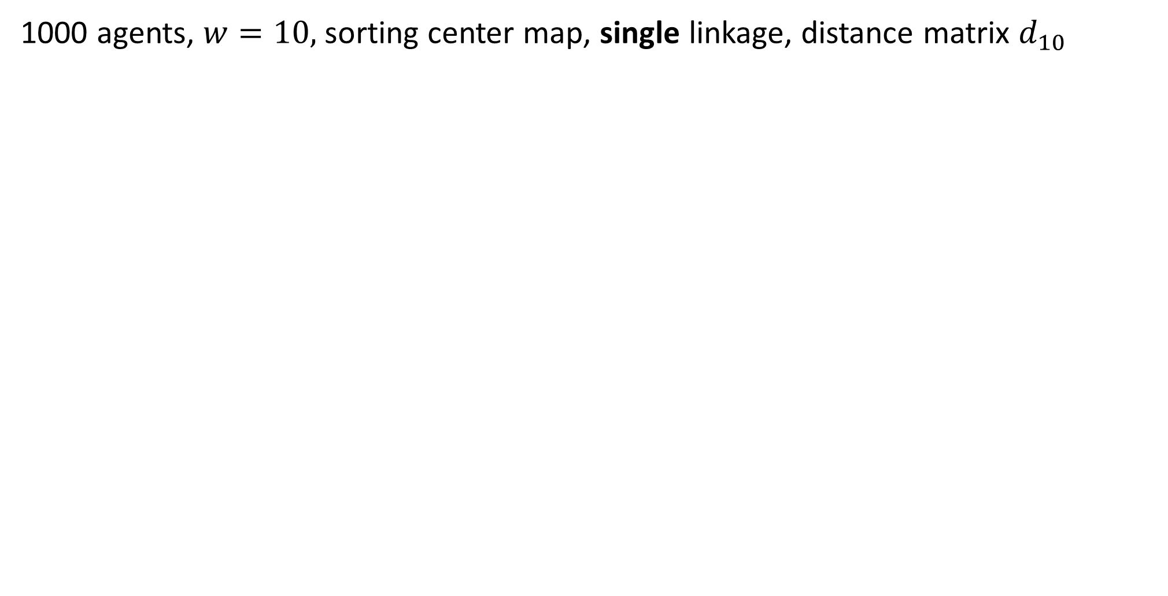
1000 agents, $w=10$, sorting center map, single linkage, distance matrix $d_{10}$

Slide 6
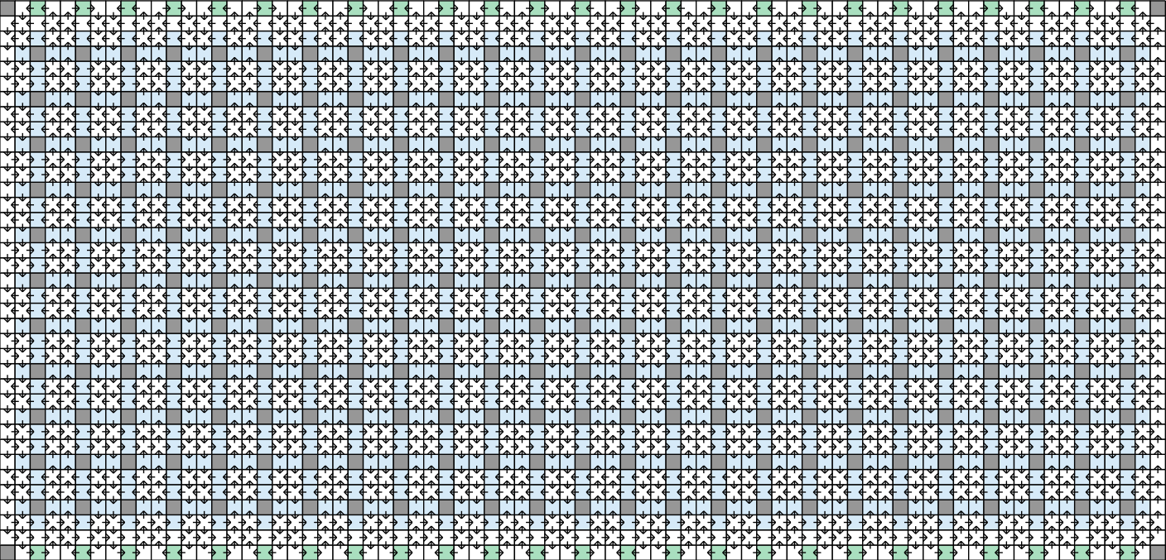

Slide 7
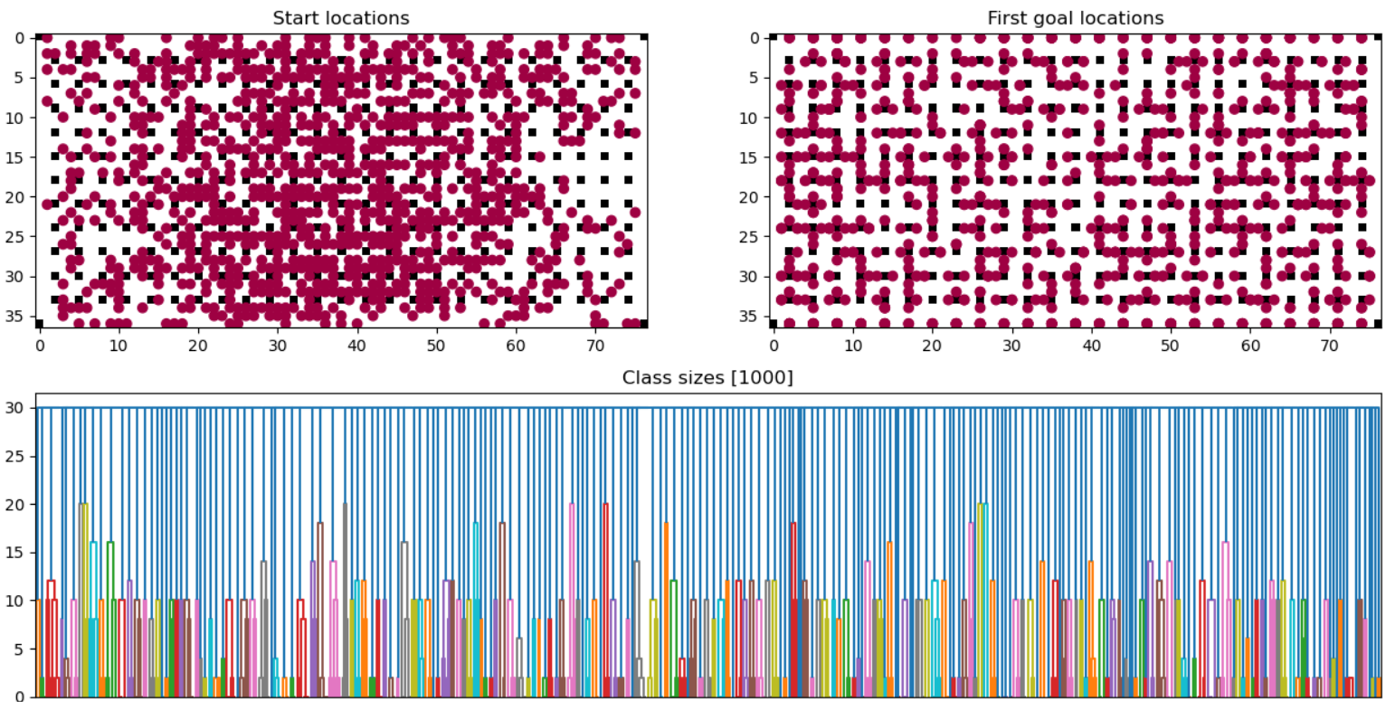
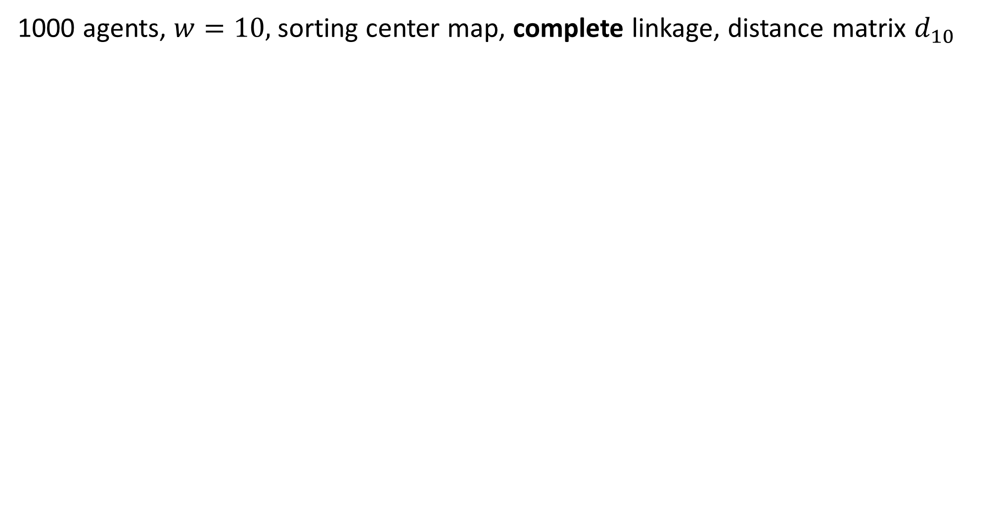
1000 agents, $w=10$, sorting center map, complete linkage, distance matrix $d_{10}$

Slide 8
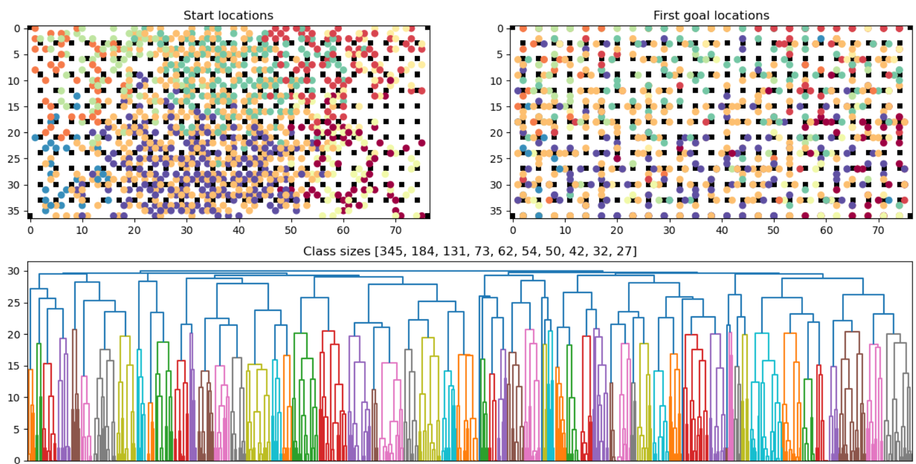
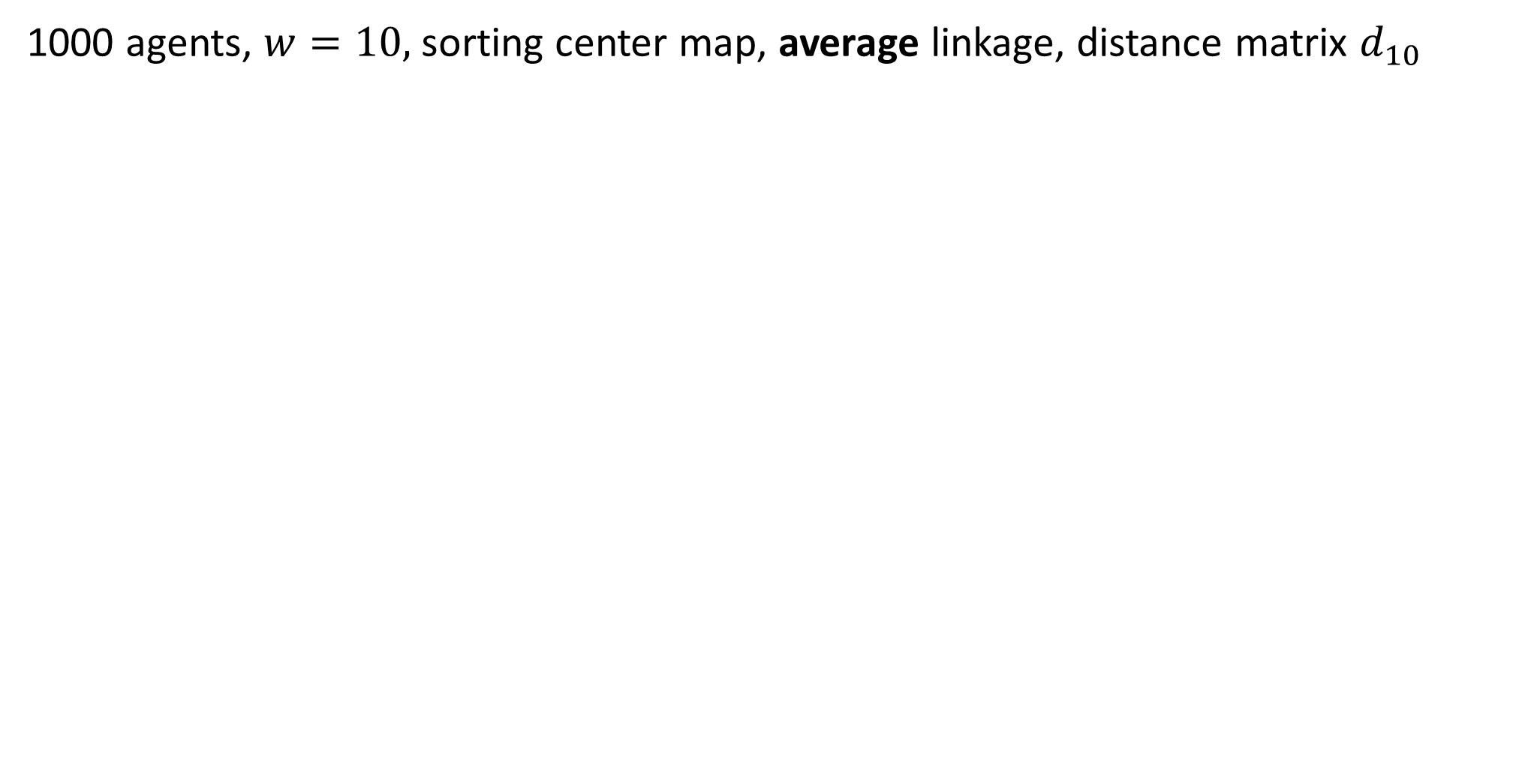
1000 agents, $w=10$, sorting center map, average linkage, distance matrix $d_{10}$

Slide 9
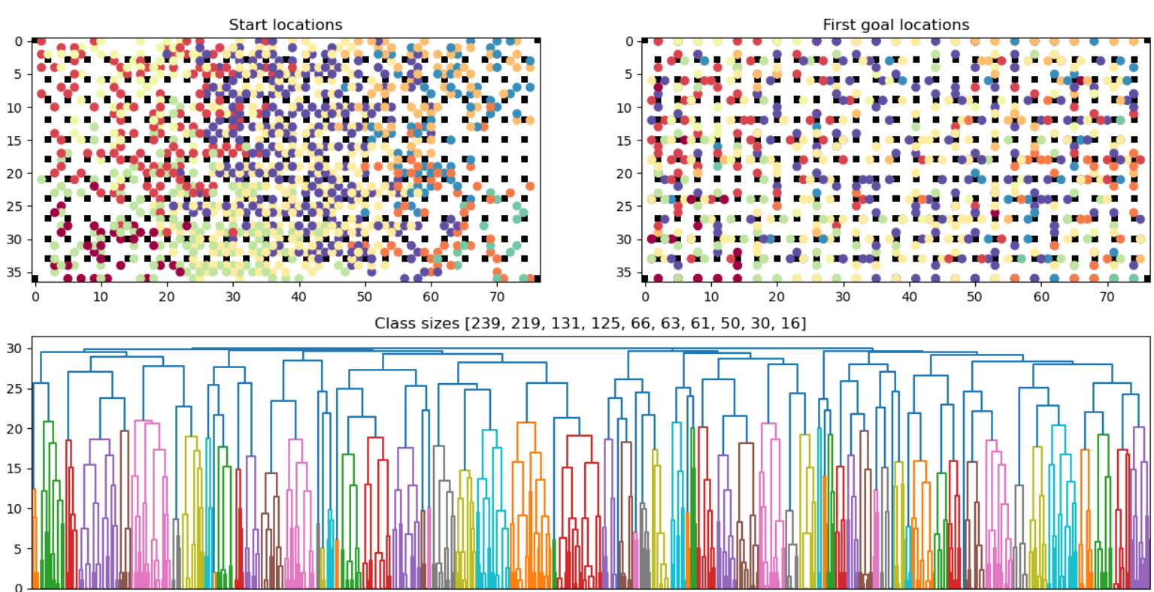
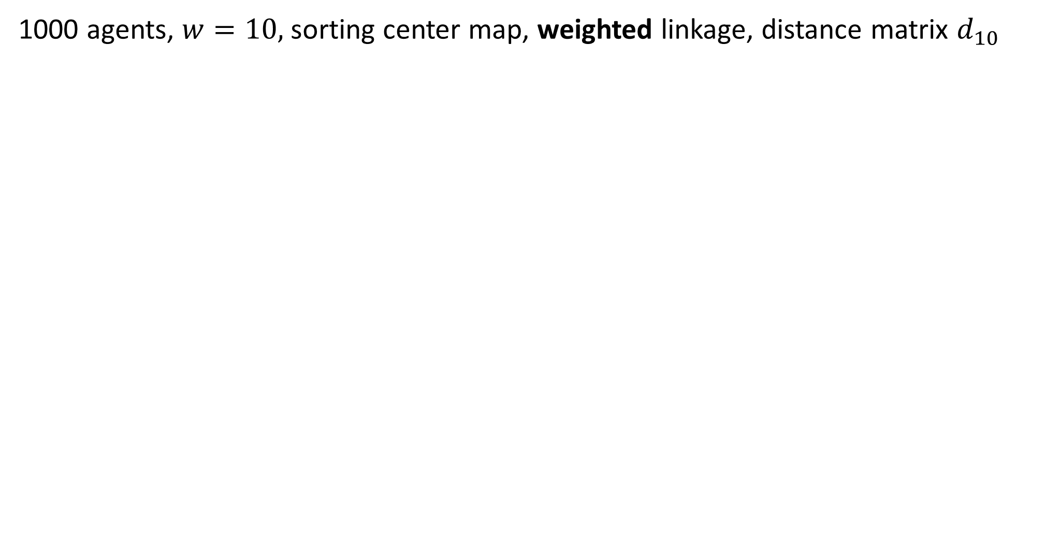
1000 agents, $w=10$, sorting center map, weighted linkage, distance matrix $d_{10}$

Slide 10
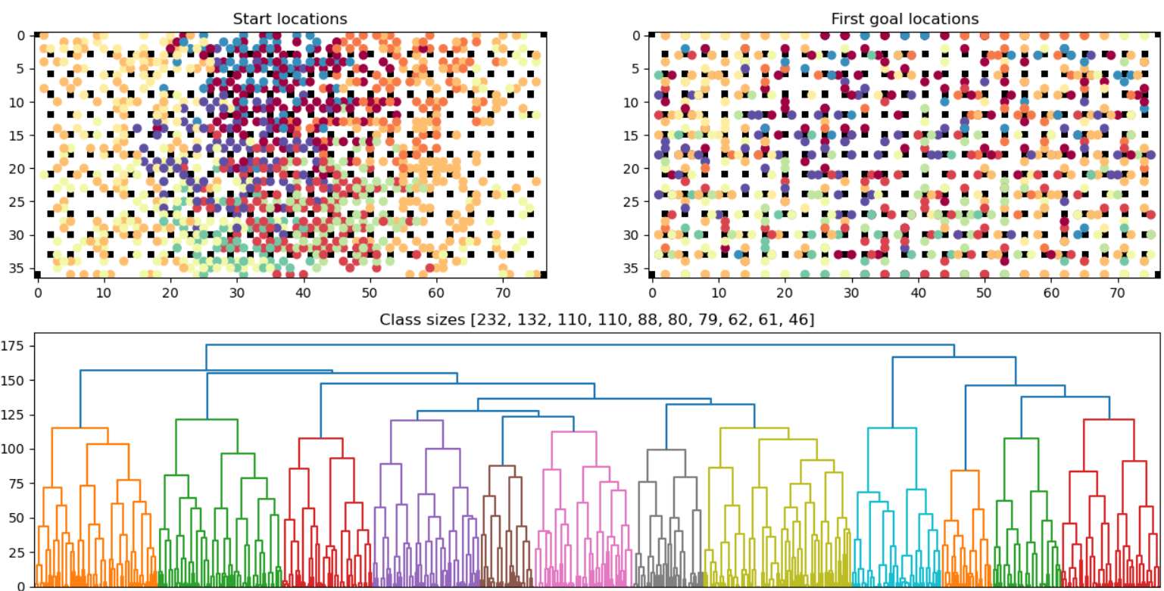
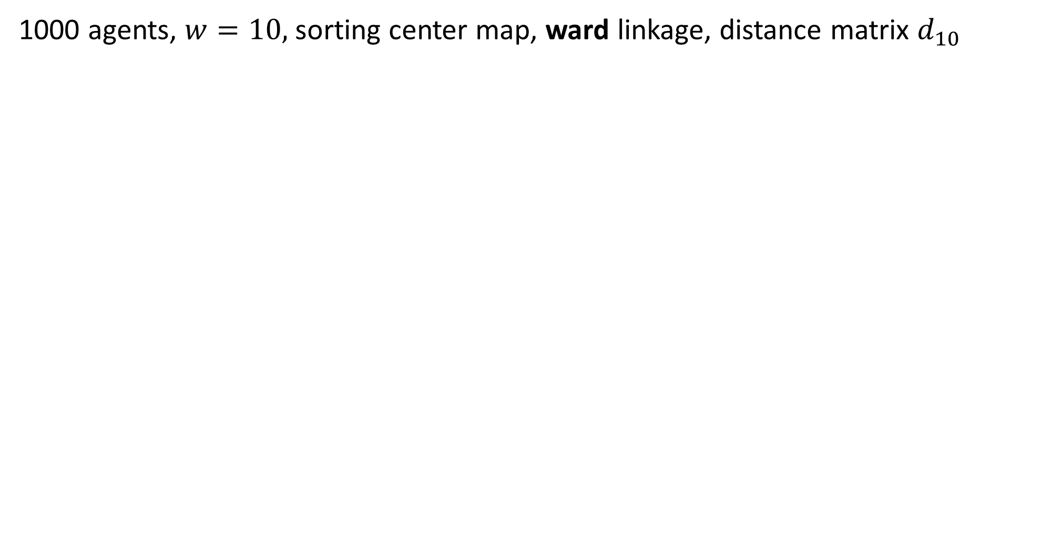
1000 agents, $w=10$, sorting center map, ward linkage, distance matrix $d_{10}$

Slide 11
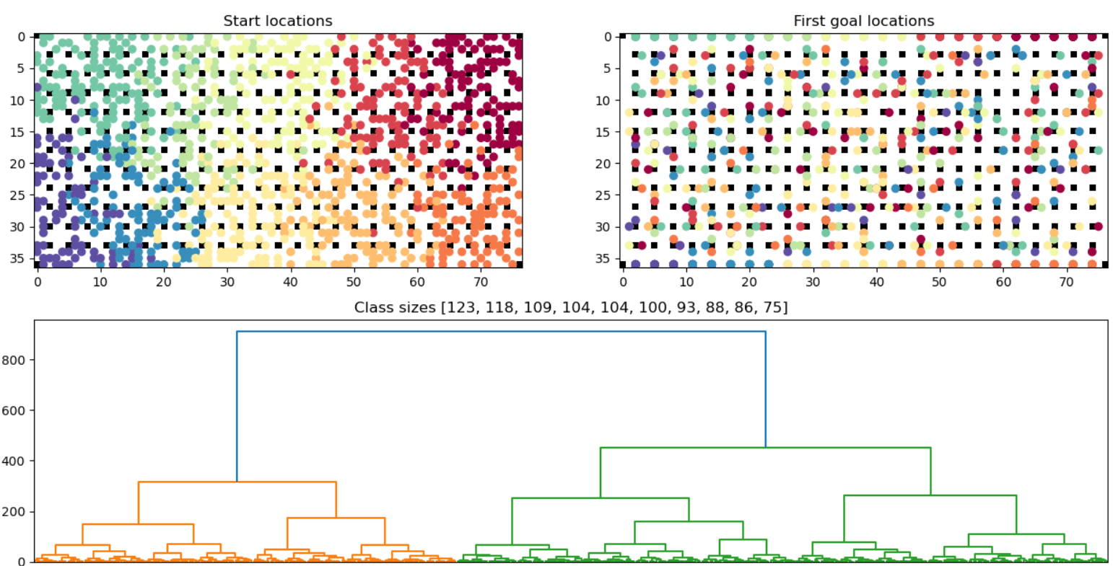
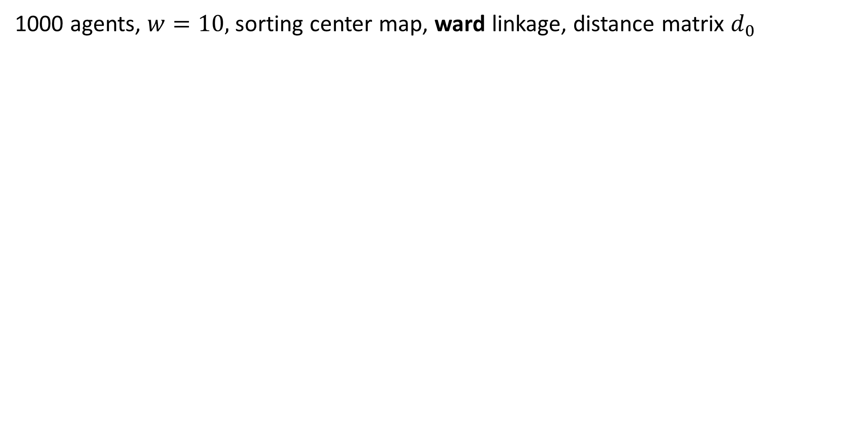
1000 agents, $w=10$, sorting center map, ward linkage, distance matrix $d_{0}$

Slide 12
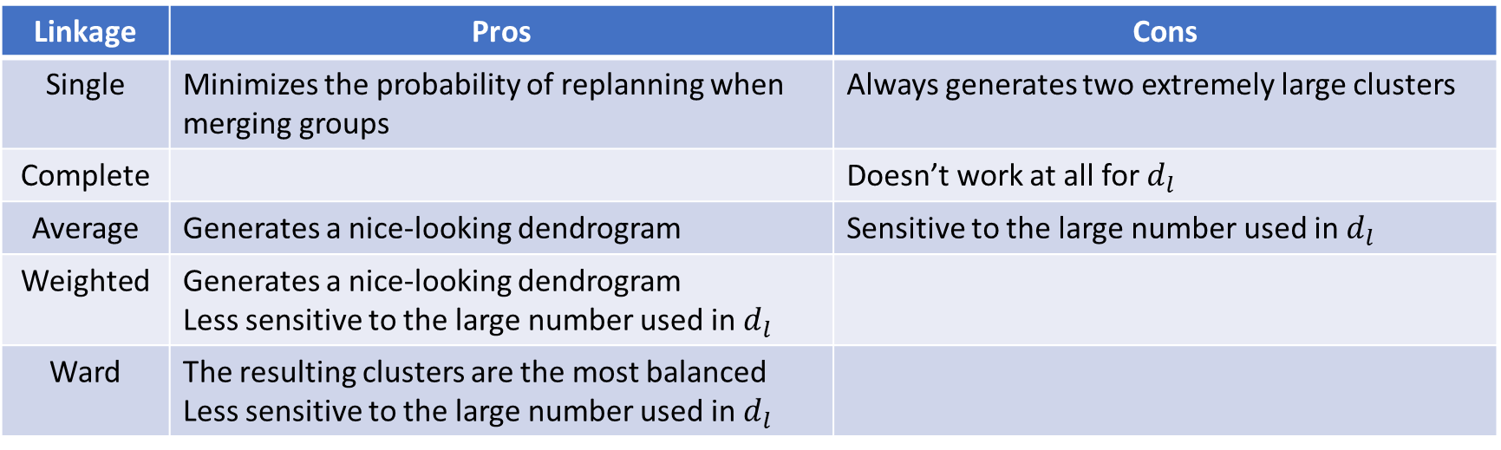
Summary
Linkage | Pros | Cons
Single | Minimizes the probability of replanning when merging groups | Always generates two extremely large clusters
Complete |  | Doesn’t work at all for $d_{l}$
Average | Generates a nice-looking dendrogram | Sensitive to the large number used in $d_{l}$
Weighted | Generates a nice-looking dendrogram Less sensitive to the large number used in $d_{l}$
Ward | The resulting clusters are the most balanced Less sensitive to the large number used in $d_{l}$

Slide 13
Resolving collisions when merging
We do not consider WHCA* because the grouping idea does not help it.
Idea 1:
Use the independence detection framework
Idea 2:
Merge the high-level trees of ECBS or PBS lazily
Similar to Wolfgang’s CBS with optimal task assignment.

Slide 14
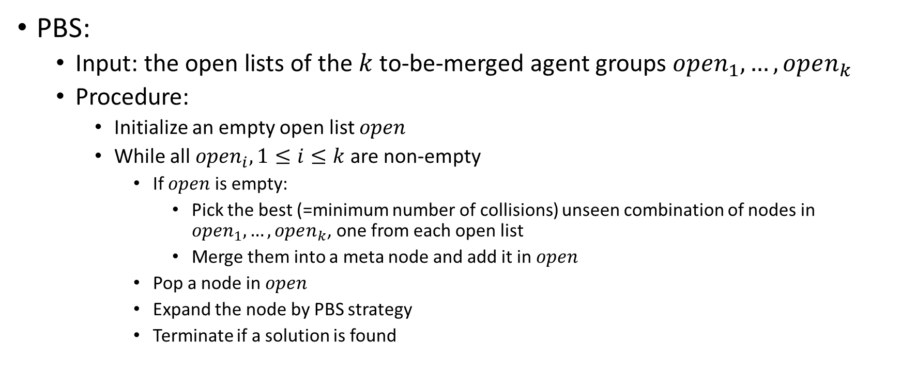
Resolving collisions when merging
PBS:
Input: the open lists of the $k$ to-be-merged agent groups $open_{1}, …, open_{k}$
Procedure:
Initialize an empty open list $open$
While all $open_{i}, 1≤i≤k$ are non-empty
If $open$ is empty:
Pick the best (=minimum number of collisions) unseen combination of nodes in $open_{1}, …, open_{k}$, one from each open list
Merge them into a meta node and add it in $open$
Pop a node in $open$
Expand the node by PBS strategy
Terminate if a solution is found

Slide 15
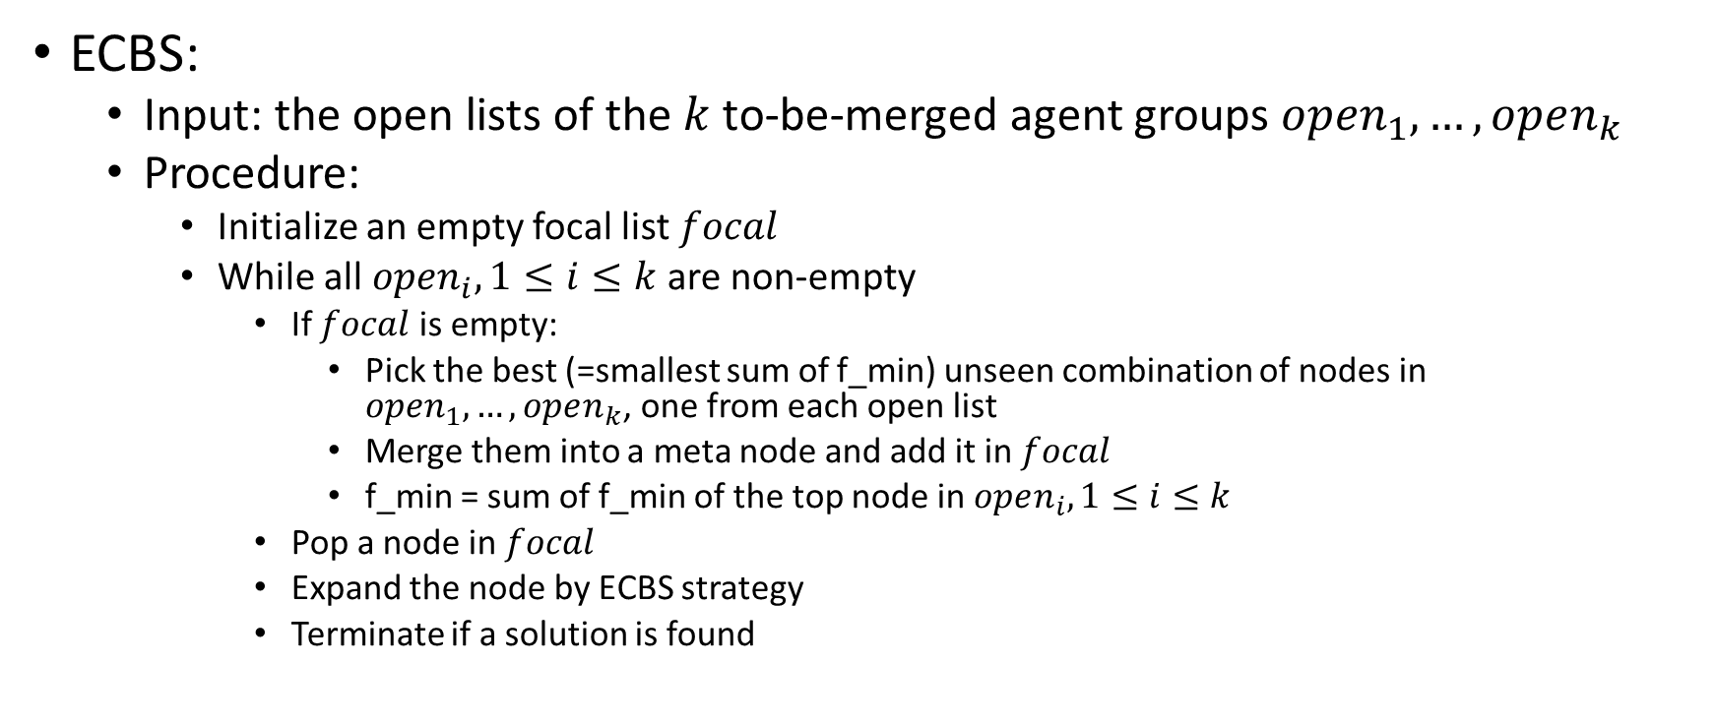
Resolving collisions when merging
ECBS:
Input: the open lists of the $k$ to-be-merged agent groups $open_{1}, …, open_{k}$
Procedure:
Initialize an empty focal list $focal$
While all $open_{i}, 1≤i≤k$ are non-empty
If $focal$ is empty:
Pick the best (=smallest sum of f_min) unseen combination of nodes in $open_{1}, …, open_{k}$, one from each open list
Merge them into a meta node and add it in $focal$
f_min = sum of f_min of the top node in $open_{i}, 1≤i≤k$
Pop a node in $focal$
Expand the node by ECBS strategy
Terminate if a solution is found

Slide 16
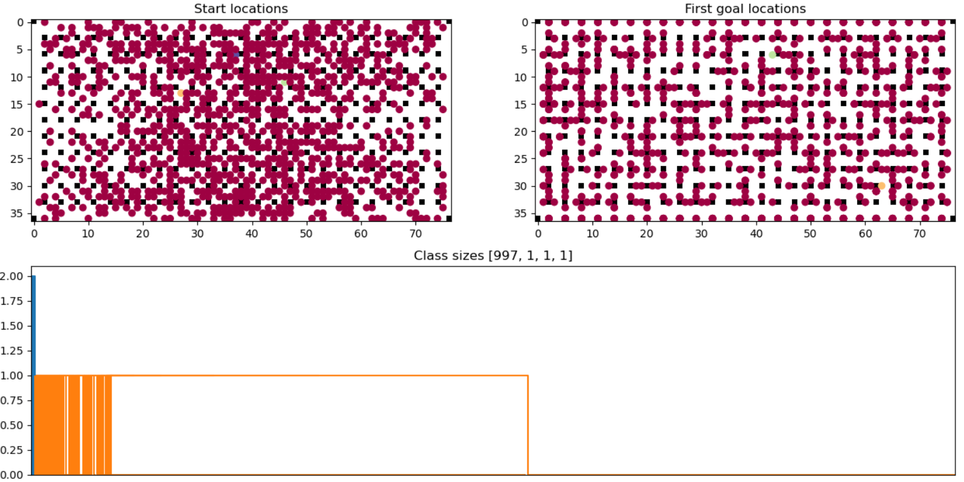
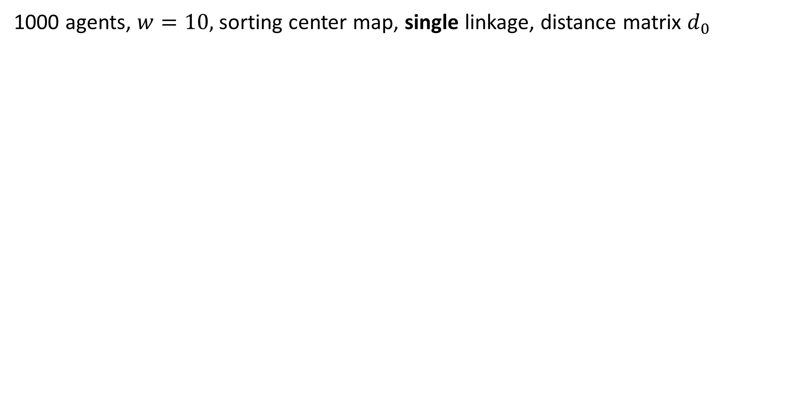
1000 agents, $w=10$, sorting center map, single linkage, distance matrix $d_{0}$

Slide 17
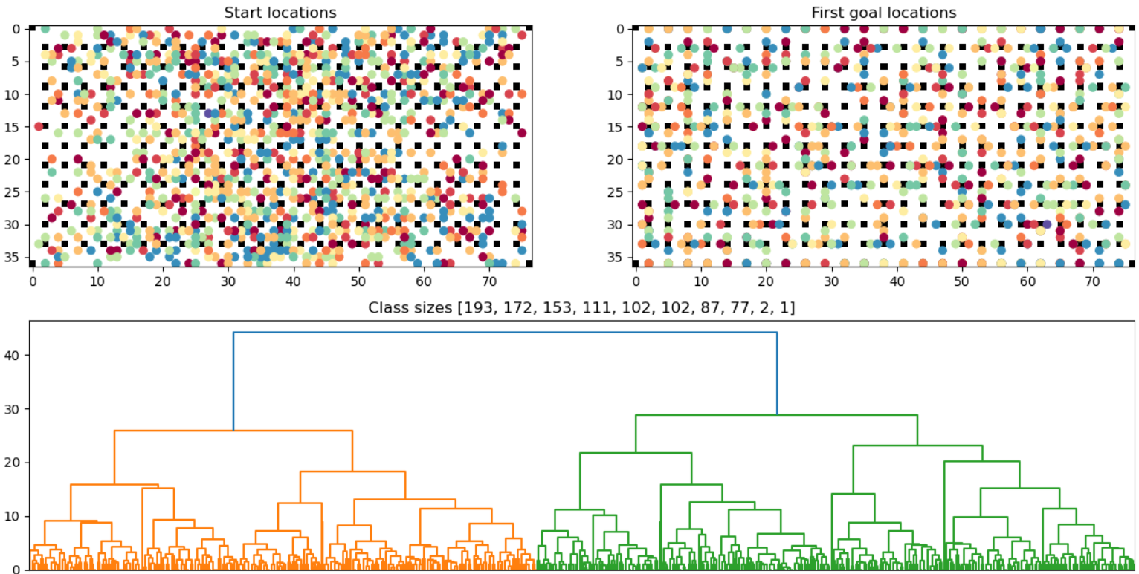
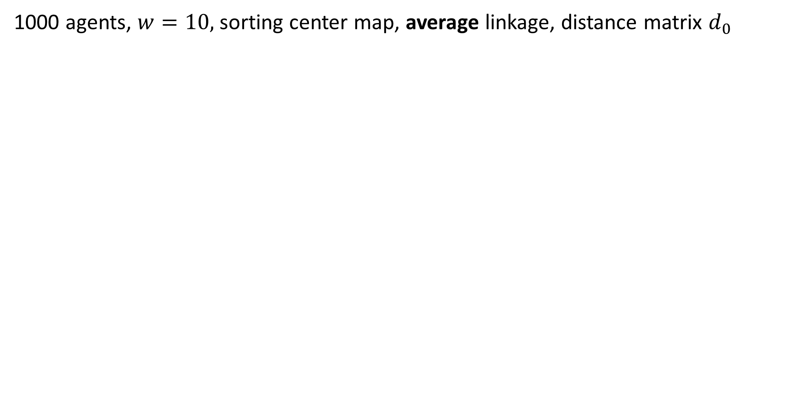
1000 agents, $w=10$, sorting center map, average linkage, distance matrix $d_{0}$

Slide 18
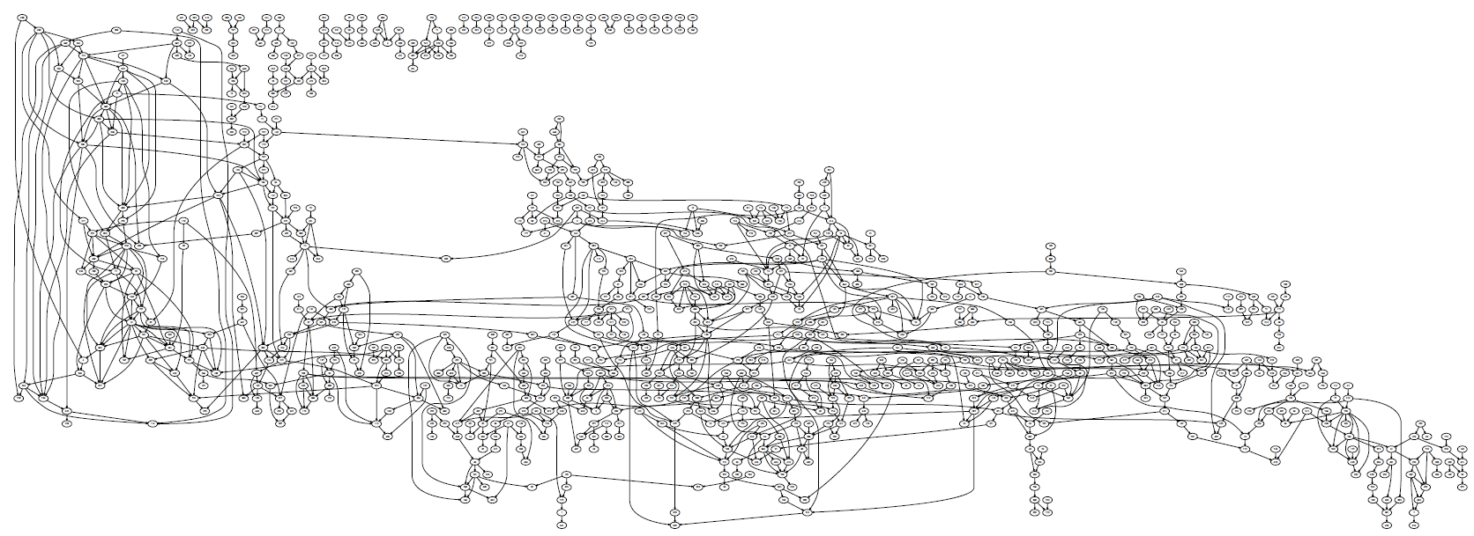
1000 agents, w=10, t=0

Slide 19
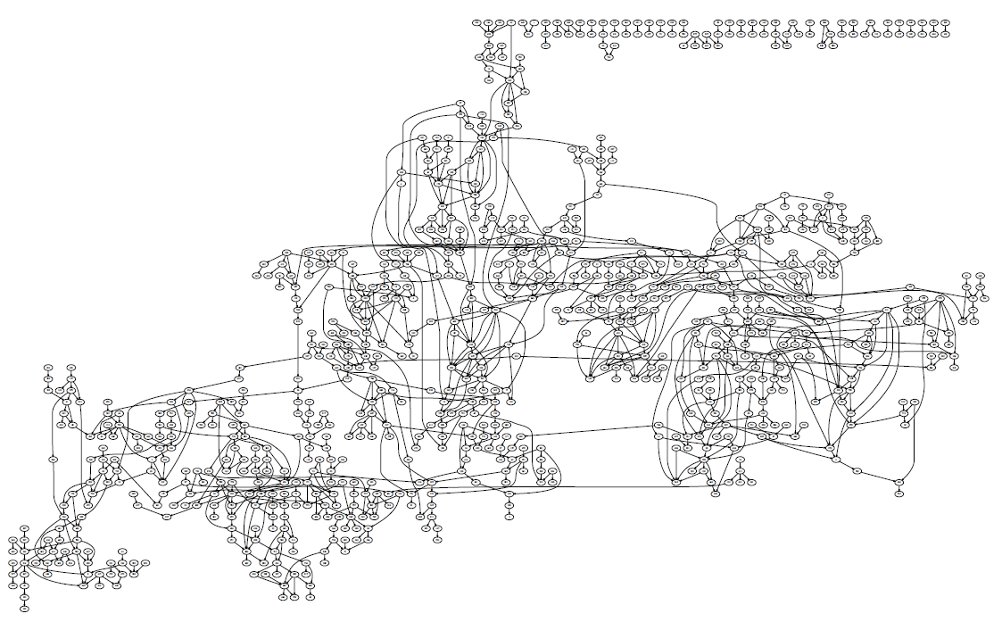
1000 agents, w=10, t=5

Slide 20
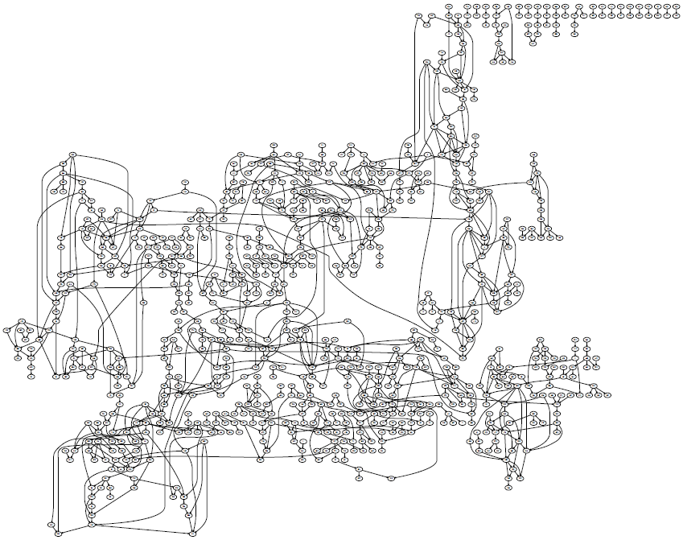
1000 agents, w=10, t=10

Slide 21
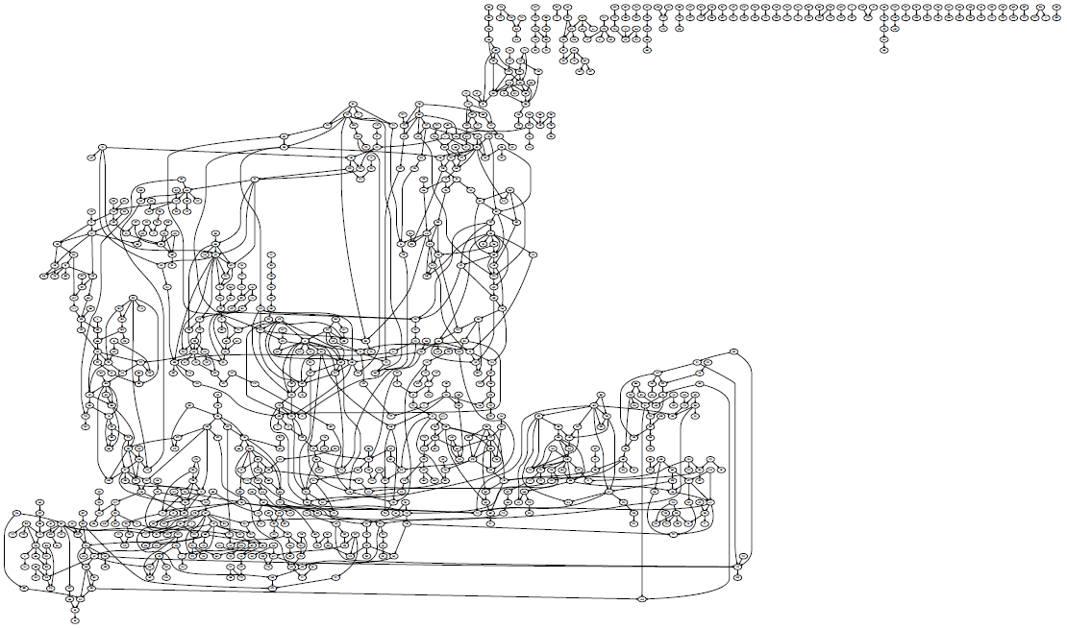
1000 agents, w=10, t=15

Slide 22
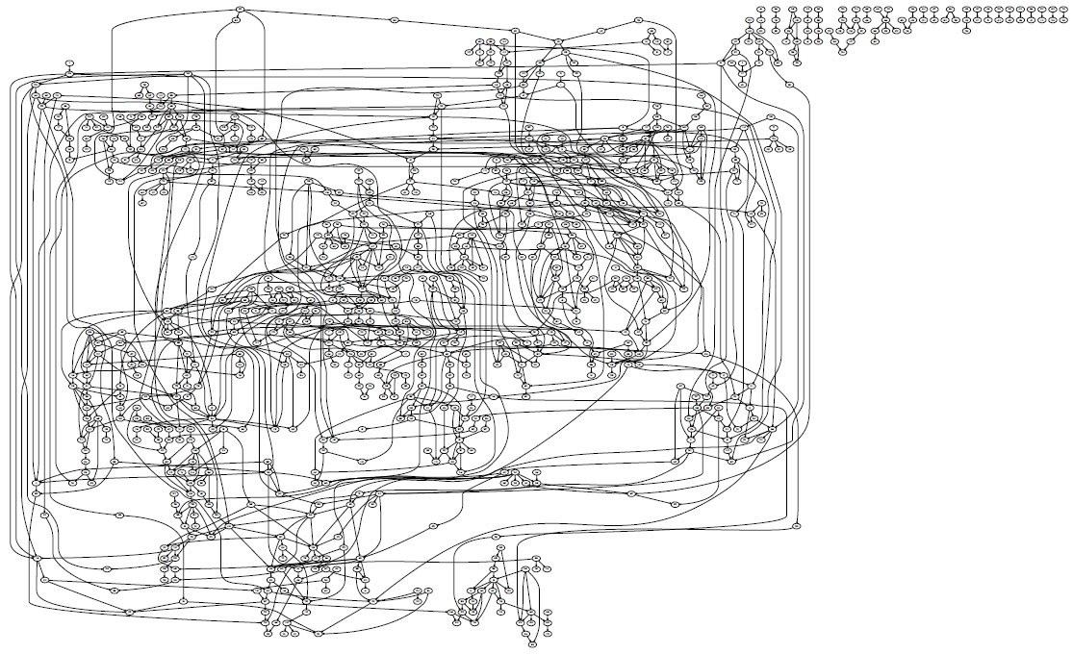
1000 agents, w=10, t=20

Slide 23
Potential Directions

